Slide 1
Logistic Regression
"Some of the figures in this presentation are taken from "An Introduction to Statistical Learning, with applications in R" (Springer, 2013) with permission from the authors: G. James, D. Witten, T. Hastie and R. Tibshirani "

Slide 2
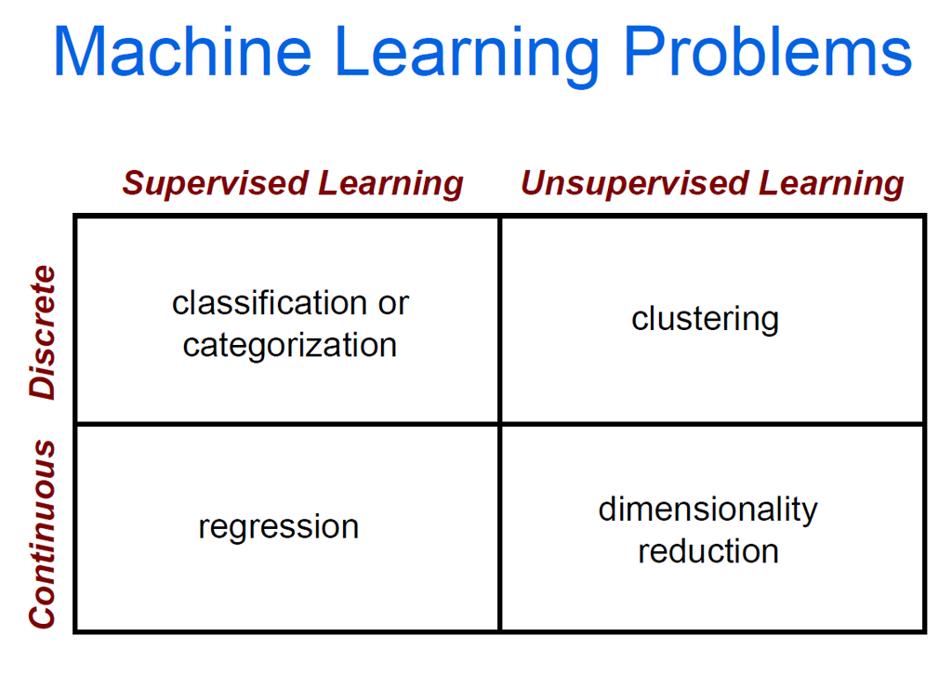
Where are we at?

Slide 3
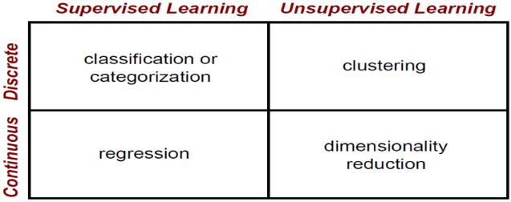
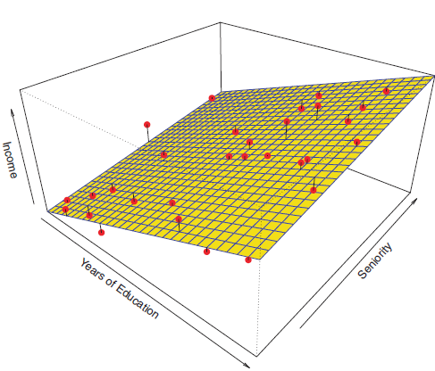
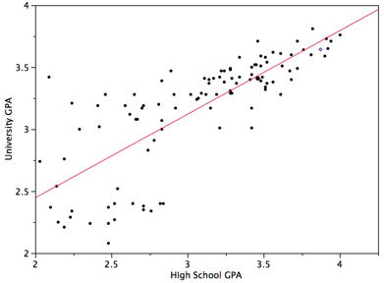
Recall linear regression
Good technique for predicting a quantitative/continuous outcome (a number)

Slide 4
We move now to classification problems
In classification you try to predict a discrete (finite) set [a,b,…,n] of categories not a continuous variable:
Email: [Spam, Not Spam]?
Online Transactions: Fraudulent [Yes, No]?
Tumor: [Malignant, Benign]?
Vision: [cat,dog,horse,lion]
Speech: Word uttered out of Vocabulary
Voting in a referendum: [yes,no]
Customer preference: [product A,product B]

Slide 5
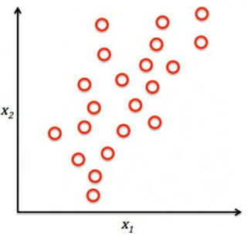
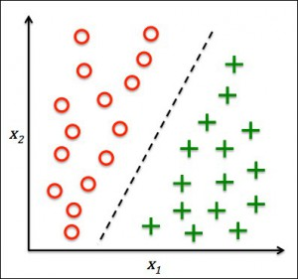
Classification
Regression
In regression problems, you try to find the trend in the data
In classification problems you try to find the boundary that separates the data into its discrete classes

Slide 6
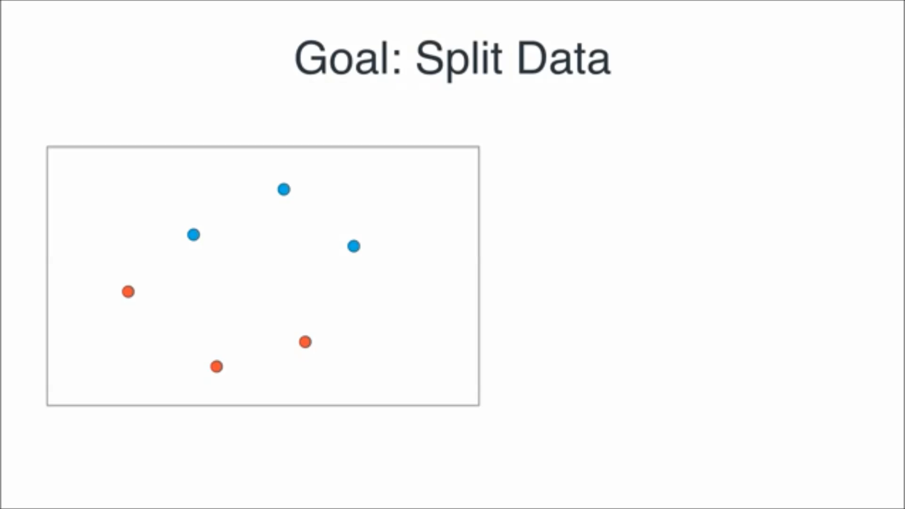
The goal of classification is to find a hyperplane (in 2D, a line) that separates the data so all instances of class 1 fall on one side of the line and all instances belonging to class 2 fall on the opposite side
Feature 2
Feature 1

Slide 7
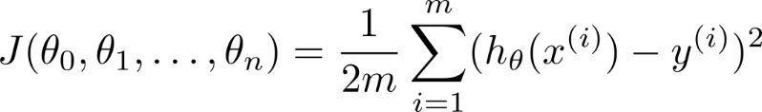
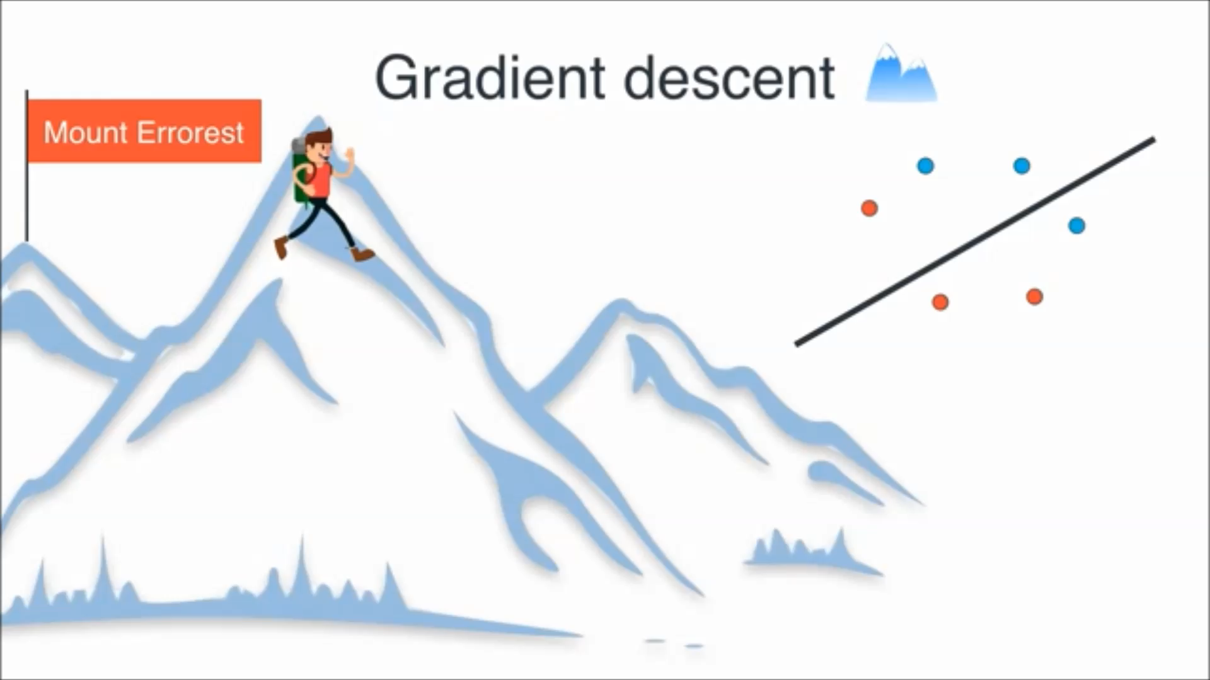

And how are we going to find the optimal line that better separates the data?
Using the gradient descent algorithm
Cost function:
J(θ₀,θ₁)
θ₀
θ₁

Slide 8
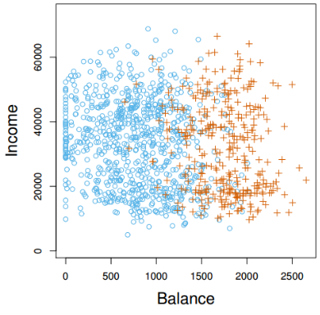
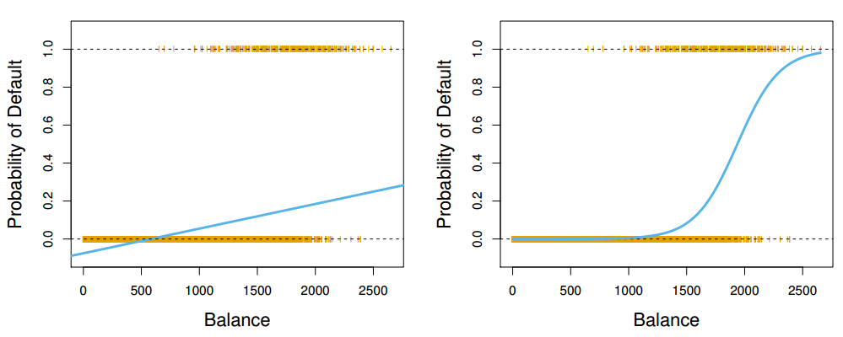
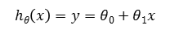
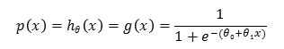
Customer defaulted on credit card payments
Linear regression would not be appropriate to solve classification problems
We need a new machine learning method that works well in classification problems
Logistic regression is a robust classification model
The model is not a line but an S shape curve
Customer did not default on credit card payments
(i.e. credit card debt)
$$p\left(x\right)=hθ\left(x\right)=g\left(x\right)=\frac{1}{1+e^{−(θ0+θ1x)}}$$
$$hθ\left(x\right)=y=θ0+θ1x$$
Linear regression
Logistic regression

Slide 9
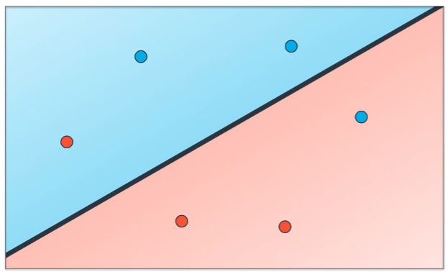
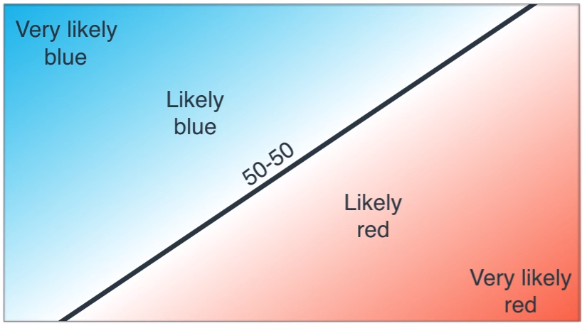
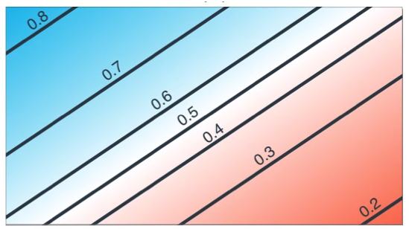
Logistic regression is a model that assigns to data instances probabilities of them belonging to one class or another based on their position in the input space

Slide 10
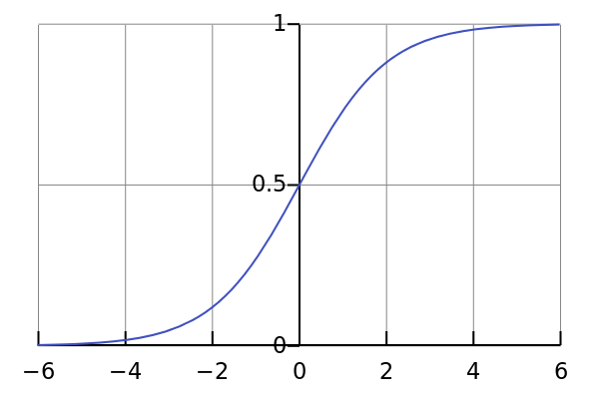
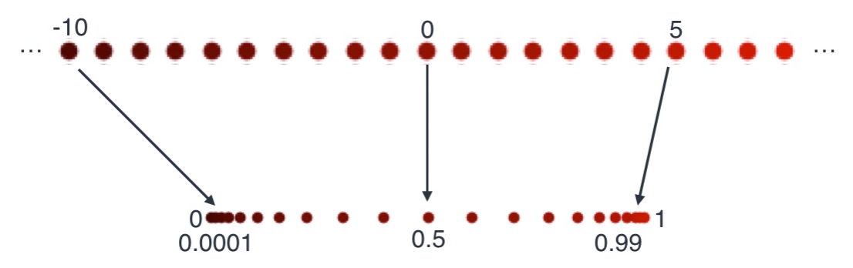
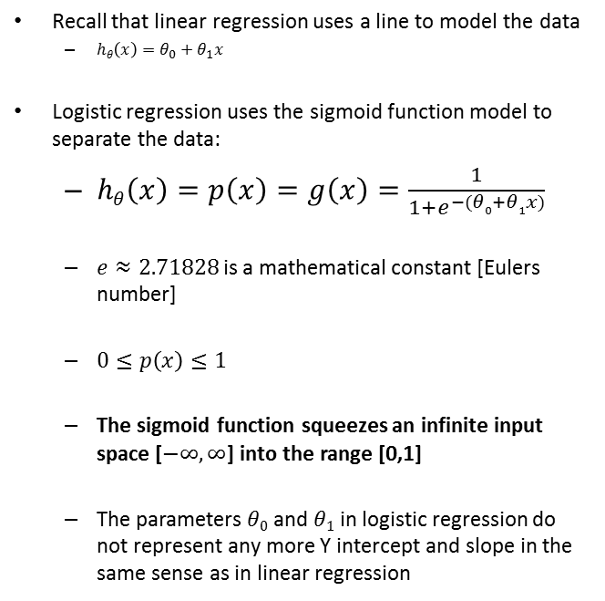
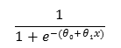
Hypotheses/model representation in Logistic regression
Sigmoid function aka
Logistic function
Recall that linear regression uses a line to model the data
$hθ\left(x\right)=θ_{0}+θ_{1}x$
Logistic regression uses the sigmoid function model to separate the data:
$hθ\left(x\right)=p\left(x\right)=g\left(x\right)=\frac{1}{1+e^{−(θ0+θ1x)}}$
$e≈2.71828$is a mathematical constant [Eulers number]
$0≤p\left(x\right)≤1$
The sigmoid function squeezes an infinite input space [$−∞,∞$] into the range [0,1]
The parameters $θ0$ and $θ1$ in logistic regression do not represent any more Y intercept and slope in the same sense as in linear regression
$$\frac{1}{1+e^{−(θ0+θ1x)}}$$

Slide 11
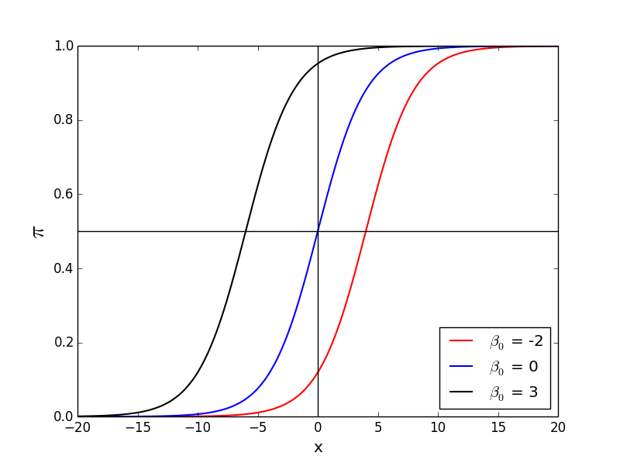
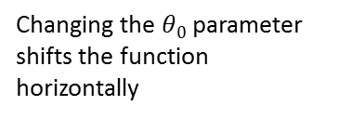
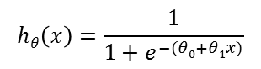
Logistic regression sigmoid function parameters
Changing the $θ0$parameter shifts the function horizontally
$$hθ\left(x\right)=\frac{1}{1+e^{−(θ0+θ1x)}}$$
$$θ0$$
$$θ0$$
$$θ0$$

Slide 12
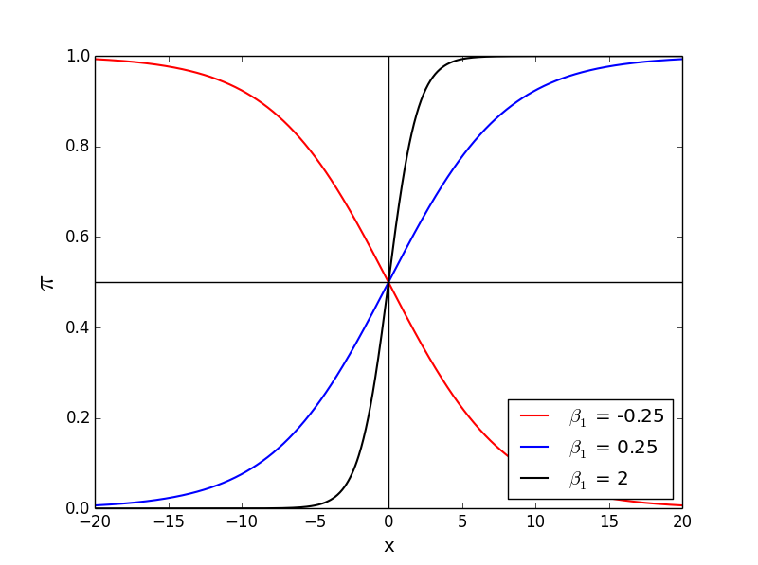
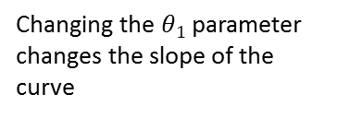
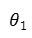
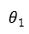
Logistic regression sigmoid function parameters
Changing the $θ1$parameter changes the slope of the curve
$$hθ\left(x\right)=\frac{1}{1+e^{−(θ0+θ1x)}}$$
$$θ1$$
$$θ0$$
$$θ1$$
$$θ0$$
$$θ1$$
$$θ0$$

Slide 13
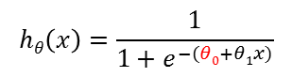
Changing the parameters of the model has an impact on model performance (aka accuracy) for classification
1
Probability of credit card fraudulent transaction
0.5
$$hθ\left(x\right)=\frac{1}{1+e^{−(θ0+θ1x)}}$$
0
Frequency of credit card transactions per hour
With the 1st value of the parameter $θ_{0}$ all data points are classified as fraudulent transactions (probability of fraudulent > 0.5)
With the 2nd value of the parameter $θ_{0}$ the model does a better job at classifying the data

Slide 14
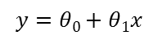
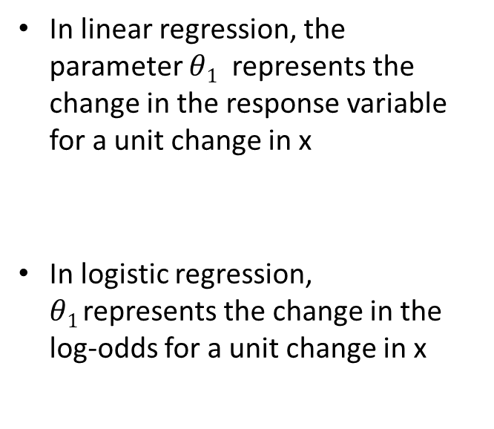
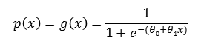
Interpretation of logistic regression parameters
In linear regression, the parameter $θ1$ represents the change in the response variable for a unit change in x
In logistic regression, $θ1$represents the change in the log-odds for a unit change in x
Y
$$y=θ0+θ1x$$
X
$$p\left(x\right)=g\left(x\right)=\frac{1}{1+e^{−(θ0+θ1x)}}$$

Slide 15
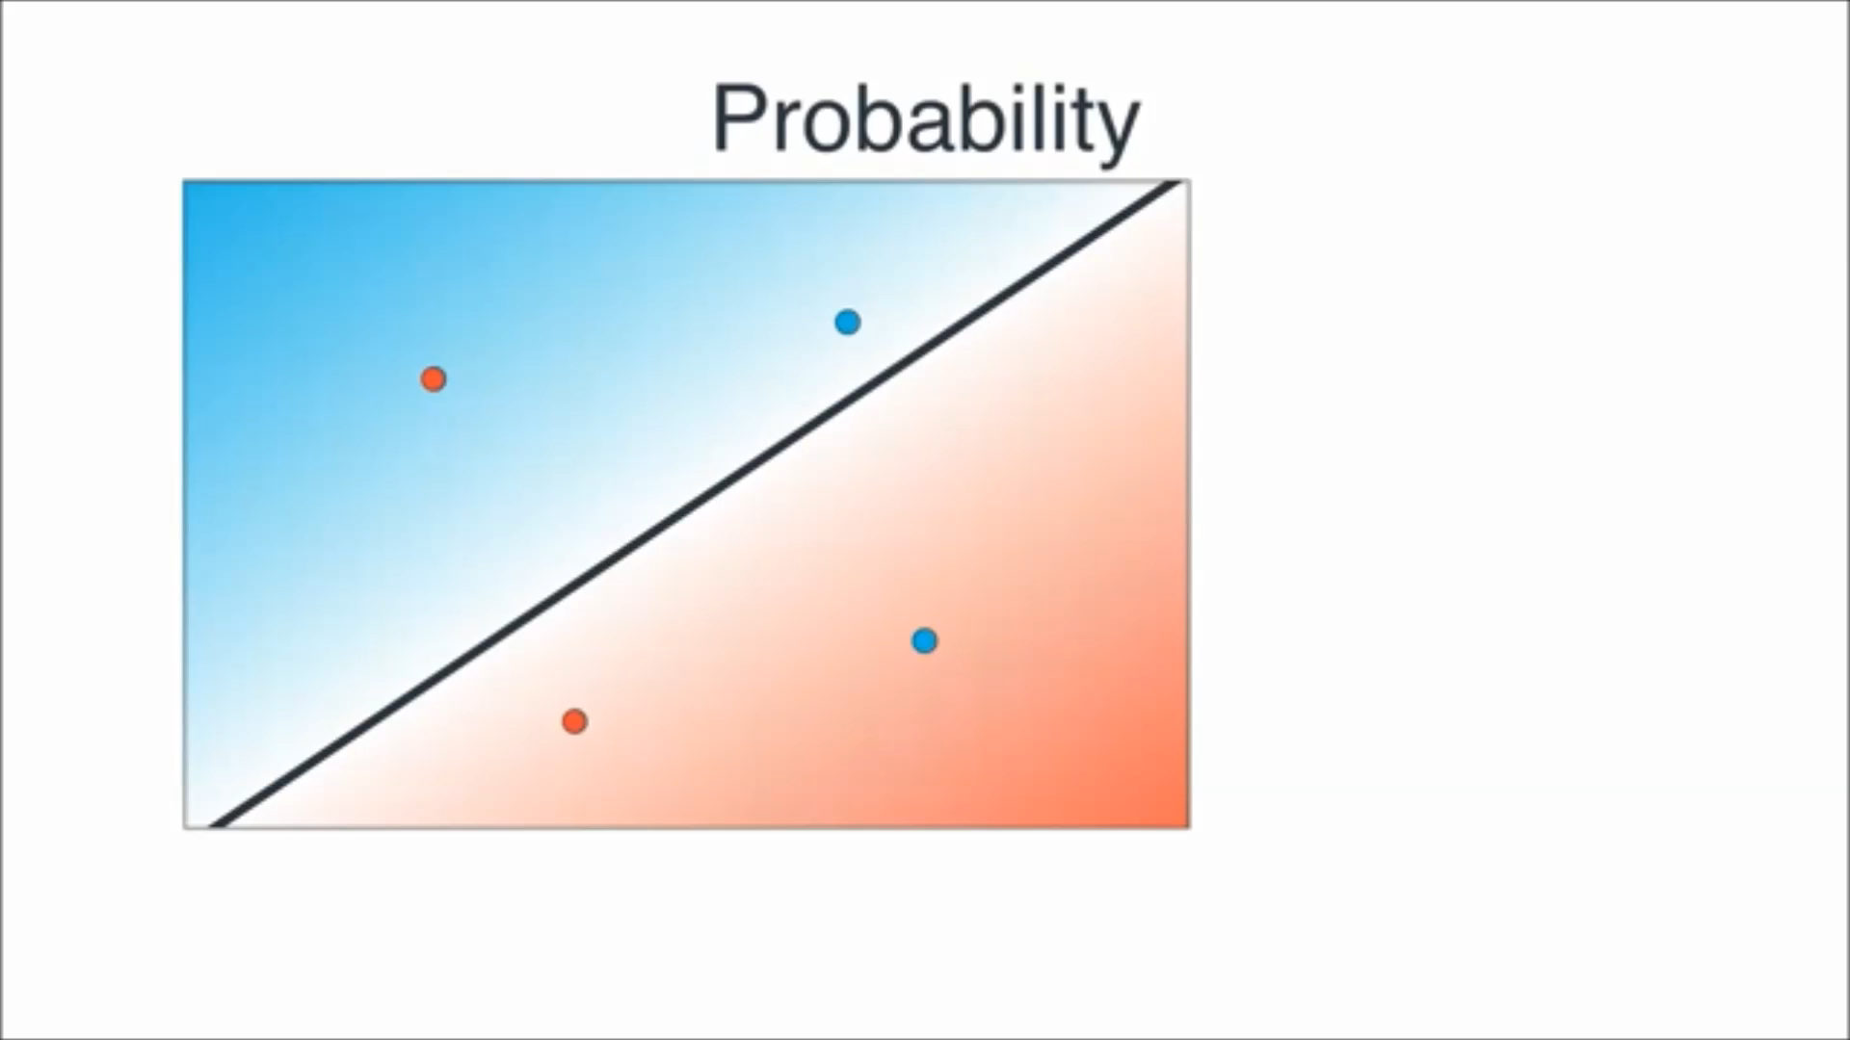
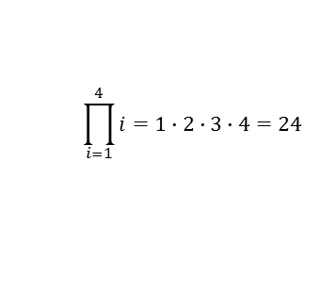
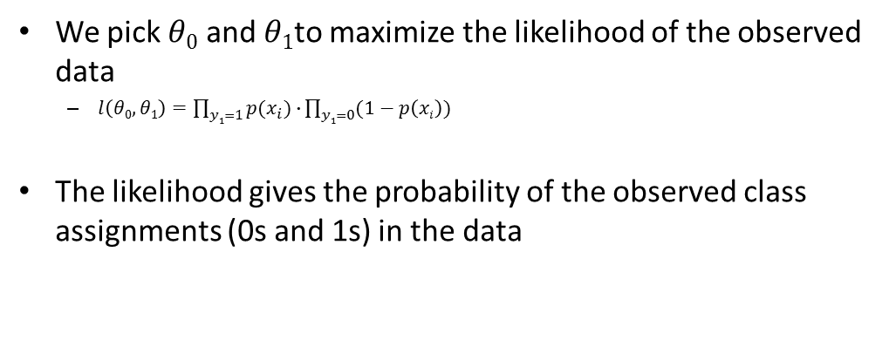
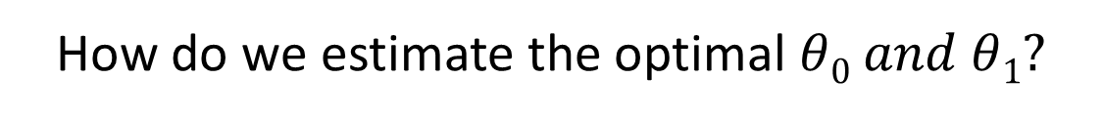
How do we estimate the optimal $θ0 and θ1?$
We pick $θ0$ and $θ1$to maximize the likelihood of the observed data
$l\left(θ0,θ1\right)=\prod_{y1=1}{p(x_{i})∙}\prod_{y1=0}{(1−p\left(xi\right))}$
The likelihood gives the probability of the observed class assignments (0s and 1s) in the data
$$\prod_{i=1}^{4}{i=1∙2∙3∙4=24}$$

Slide 16
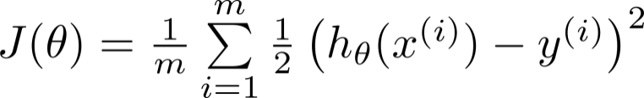
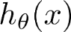
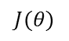
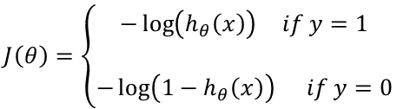
Assessing how good is the logistic regression model: the logistic regression cost function
Linear regression cost function:
$$J\left(θ\right)=\left\{\begin{matrix}\begin{aligned}−\log\left(h_{θ}\left(x\right)\right) if y=1 \\ \end{aligned} \\ −\log\left(1−h_{θ}\left(x\right)\right) if y=0\end{matrix}\right.$$
Logistic regression uses a different cost function: the Log-likelihood cost function
Analogous to the residual sum of squares in multiple regression
It is an indicator of how much unexplained information there is after the model has been fitted
Large values indicate poorly fitting statistical models
$$J(θ)$$
0
1

Slide 17
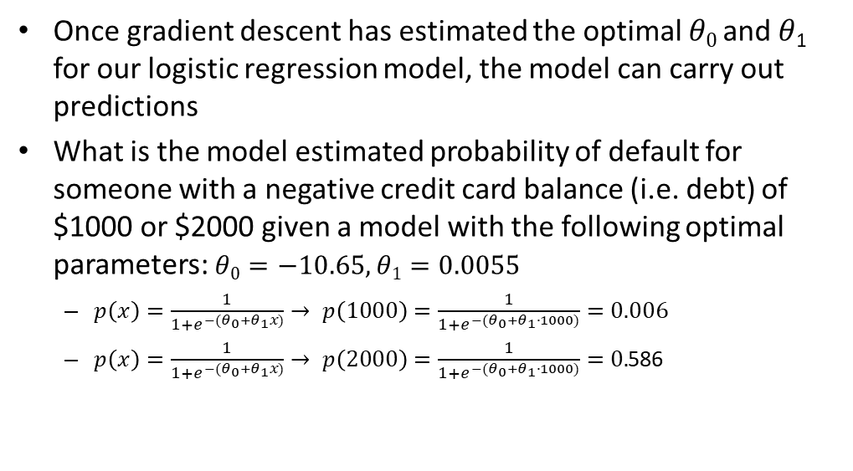
Making predictions
Once gradient descent has estimated the optimal $θ0$ and $θ$₁ for our logistic regression model, the model can carry out predictions
What is the model estimated probability of default for someone with a negative credit card balance (i.e. debt) of $1000 or $2000 given a model with the following optimal parameters: $θ0=−10.65, θ1=0.0055$
$p\left(x\right)=\frac{1}{1+e^{{−(θ}_{0}+θ_{1}x)}}→ p\left(1000\right)=\frac{1}{1+e^{−(θ_{0}+θ_{1}∙1000)}}=0.006$
$p\left(x\right)=\frac{1}{1+e^{{−(θ}_{0}+θ_{1}x)}}→ p\left(2000\right)=\frac{1}{1+e^{{−(θ}_{0}+θ_{1}∙1000)}}=0.$586

Slide 18
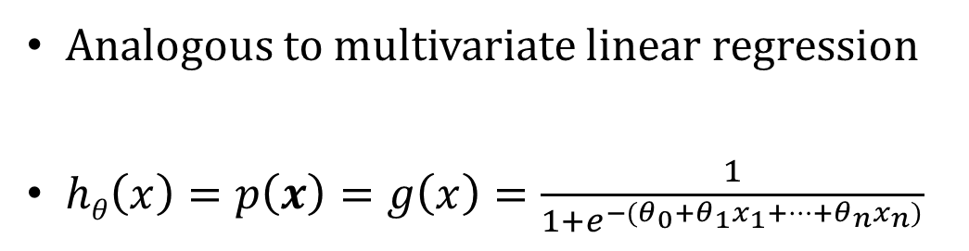
Logistic regression with several predictors
Analogous to multivariate linear regression
$hθ\left(x\right)=p\left(x\right)=g\left(x\right)=\frac{1}{1+e^{{−(θ}_{0}+θ_{1}x_{1}+…+θ_{n}x_{n})}}$

Slide 19
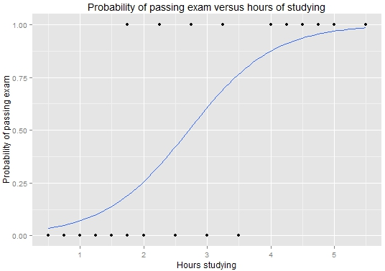
I emphasized again the importance of realizing the probabilistic interpretation of Logistic regression
By Michaelg2015 (Own work) [CC BY-SA 4.0 (http://creativecommons.org/licenses/by-sa/4.0)], via Wikimedia Commons

Slide 20
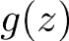
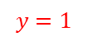
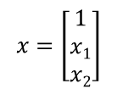
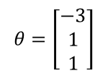
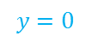
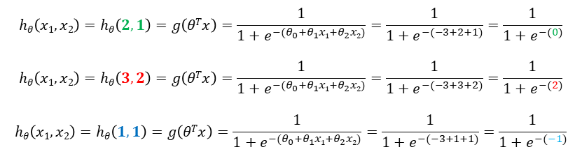
In Logistic regression the decision Boundary represents the 50% probability of assignment to either class in a binary classification problem
Optimal Parameters of the model
Feature vector
x₂
3
$$y=1$$
$$θ=\left[\begin{matrix}−3 \\ 1 \\ 1\end{matrix}\right]$$
$$x=\left[\begin{matrix}1 \\ x1 \\ x2\end{matrix}\right]$$
2
1
Decision boundary
$$y=0$$
x₁
1
2
3
$$hθ\left(x1,x2\right)=hθ\left(2,1\right)=g\left(θTx\right)=\frac{1}{1+e^{{−(θ}_{0}+θ_{1}x1+θ_{2}x2)}}=\frac{1}{1+e^{−(−3+2+1)}}=\frac{1}{1+e^{−(0)}}$$
$$hθ\left(x1,x2\right)=hθ\left(3,2\right)=g\left(θTx\right)=\frac{1}{1+e^{{−(θ}_{0}+θ_{1}x1+θ_{2}x2)}}=\frac{1}{1+e^{−(−3+3+2)}}=\frac{1}{1+e^{−(2)}}$$
$$hθ\left(x1,x2\right)=hθ\left(1,1\right)=g\left(θTx\right)=\frac{1}{1+e^{{−(θ}_{0}+θ_{1}x1+θ_{2}x2)}}=\frac{1}{1+e^{−(−3+1+1)}}=\frac{1}{1+e^{−(−1)}}$$

Slide 21
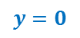
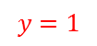

What happens with data sets that are not linearly separable?
Non-linear decision boundaries can be achieved in logistic regression using higher order polynomials:
Again, analogous to multivariate polynomial linear regression
x₂
$$y=1$$
1
$$hθ\left(x\right)=\frac{1}{1+e^{{−(θ}_{0}+θ_{1}x+θ_{2}x2+θ_{3}{x1}^{2}+θ_{4}{x2}^{2})}}$$
$$y=0$$
x₁
-1
1
-1

Slide 22

Non-linear decision boundaries with higher order polynomials:
x₂
$$hθ\left(x\right)=\frac{1}{1+e^{{−(θ}_{0}+θ_{1}x+θ_{2}x2+θ_{3}{x1}^{2}+θ_{4}{x1}^{2}x2+θ_{5}{x1}^{2}x22+…)}}$$
x₁
Convoluted nonlinear decision boundaries are possible but as the dimensionality of the problem increases this approach quickly becomes computational intractable due to the combinatorial explosion of features
There are more appropriate algorithms for high dimensional problems (Support vector machines aka SVMs, or deep neural networks)

Slide 23










So far, we have only talked about binary classification problems. What happens when we have more than 2 classes? Multiclass classification or multinomial logistic regression
Email foldering/tagging: Work, Friends, Family, Hobby
$$y=0$$
$y=$1
$$y=2$$
$y=$3
Medical diagrams: Not ill, Cold, Flu
$$y=0$$
$y=$1
$$y=2$$
Weather: Sunny, Cloudy, Rain, Snow
$$y=0$$
$y=$1
$$y=2$$
$y=$3

Slide 24





Binary classification:
Multi-class classification:
$y=$1
$y=$1
$$y=2$$
x₂
x₂
$$y=0$$
$$y=0$$
x₁
x₁

Slide 25
One-vs-all (one-vs-rest):
x₂
x₁
x₂
x₂
x₁
x₁
Class 1:
Class 2:
Class 3:
x₂
x₁

Slide 26




One-vs-all
Train a logistic regression classifier for each class to predict the probability that .
On a new input , to make a prediction, pick the class that maximizes

Slide 27

Practical: MNIST the “Hello World!” of Classification

Slide 28




A word about flattening arrays in computer vision as a way of representing images as rows of $X$
$$X$$
Since each image has 28 by 28 pixels, we get a 28x28 array. We can flatten each array into a 28∗28=78428∗28=784 dimensional vector. Each component of the vector is a value between zero and one describing the intensity of the pixel. Thus, we generally think of MNIST as being a collection of 784-dimensional vectors.

Slide 29
References
https://www.coursera.org/learn/machine-learning
https://faculty.marshall.usc.edu/gareth-james/ISL/

